Slide 1

David M. Kroenke and David J. Auer Database Processing Fundamentals, Design, and Implementation
Chapter Five:
Data Modeling with the
Entity-Relationship Model

Slide 2
Chapter Objectives
To understand the two-phase data modeling/database design process
To understand the purpose of the data modeling process
To understand entity-relationship (E-R) diagrams
To be able to determine entities, attributes, and relationships
To be able to create entity identifiers
To be able to determine minimum and maximum cardinalities

Slide 3
Chapter Objectives
To understand variations of the E-R model
To understand and be able to use ID-dependent and other weak entities
To understand and be able to use supertype/subtype entities
To understand and be able to use strong entity patterns
To understand and be able to use the ID-dependent association pattern
To understand and be able to use the ID-dependent multivalued attribute pattern

Slide 4
Chapter Objectives
To understand and be able to use the ID-dependent archetype/instance pattern
To understand and be able to use the line-item pattern
To understand and be able to use the for-use-by pattern
To understand and be able to use recursive patterns
To understand the iterative nature of the data modeling process
To be able to use the data modeling process

Slide 5
The Data Model
A data model is a plan or blueprint for a database design.
A data model is more generalized and abstract than a database design.
It is easier to change a data model then it is to change a database design, so it is the appropriate place to work through conceptual database problems.
Notes:
Data model의 정의: wikipedia 참조

Slide 6
E-R Model
Entity-Relationship model is a set of concepts and graphical symbols that can be used to create conceptual schemas.
Versions:
Original E-R model—by Peter Chen (1976)
Extended E-R model—extensions to the Chen model
Information Engineering (IE)—by James Martin (1990); uses “crow’s foot” notation, is easier to understand, and we will use it
IDEF1X—a national standard developed by the National Institute of Standards and Technology [see Appendix B]
Unified Modeling Language (UML)—by the Object Management Group; it supports object-oriented methodology [see Appendix C]
Notes:
E-R data model의 설명: https://en.wikipedia.org/wiki/Entity%E2%80%93relationship_model
- 위의 내용도 Chen과 IE 표기에 초점을 두고 있음.
각각의 모델들에 대해 구글링. 또는 위키피디어를 검색할 것.

Slide 7
Entities
Something that can be identified and the users want to track:
Entity class—a collection of entities of a given type
Entity instance—the occurrence of a particular entity
There are usually many instances of an entity in an entity class.

Slide 8
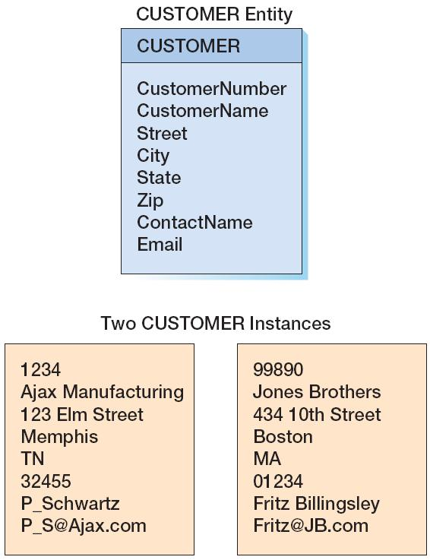
CUSTOMER: The Entity Class and Two Entity Instances

Slide 9
Attributes
Attributes describe an entity’s characteristics.
All entity instances of a given entity class have the same attributes, but vary in the values of those attributes.
Originally shown in data models as ellipses.
Data modeling products today commonly show attributes in rectangular form.

Slide 10
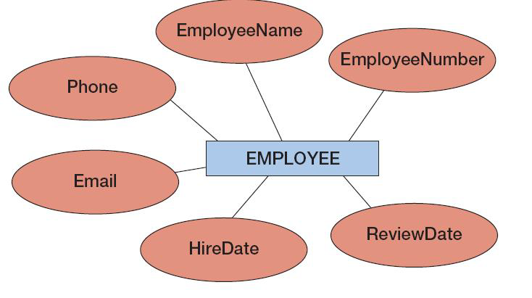
EMPLOYEE: Attributes in Ellipses

Slide 11
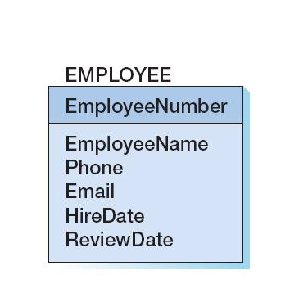
EMPLOYEE: Attributes in Entity Rectangle

Slide 12
Identifiers
Identifiers are attributes that name, or identify, entity instances.
The identifier of an entity instance consists of one or more of the entity’s attributes.
Composite identifiers are identifiers that consist of two or more attributes.
Identifiers in data models become keys in database designs.
Entities have identifiers.
Tables (or relations) have keys.

Slide 13
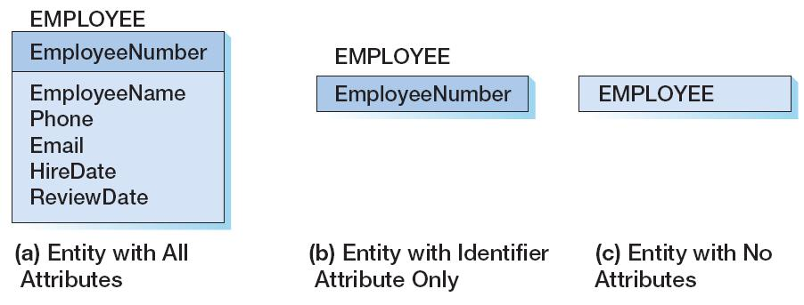
Entity Attribute Display in Data Models

Slide 14
Relationships
Entities can be associated with one another in relationships:
Relationship classes: associations among entity classes
Relationship instances: associations among entity instances
In the original E-R model, relationships could have attributes, but today this is no longer done.
A relationship class can involve two or more entity classes.

Slide 15
Degree of the Relationship
The degree of the relationship is the number of entity classes in the relationship:
Two entities have a binary relationship of degree two.
Three entities have a ternary relationship of degree three.

Slide 16
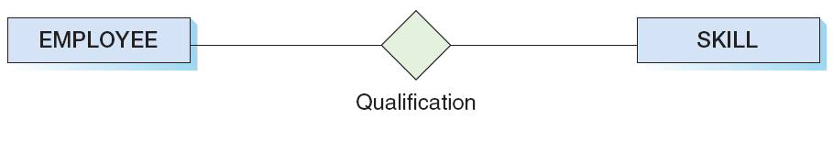
Binary Relationship

Slide 17
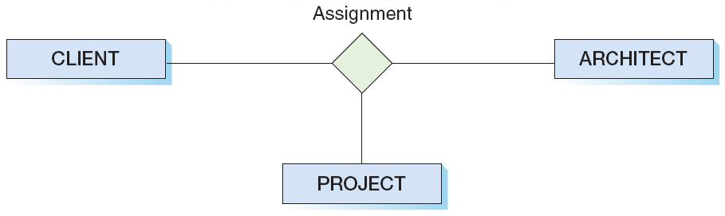
Ternary Relationship

Slide 18
Entities and Tables
The principle difference between an entity and a table (relation) is that you can express a relationship between entities without using foreign keys.
This makes it easier to work with entities in the early design process where the very existence of entities and the relationships between them is uncertain.

Slide 19
Cardinality
Cardinality means “count,” and is expressed as a number.
Maximum cardinality is the maximum number of entity instances that can participate in a relationship.
Minimum cardinality is the minimum number of entity instances that must participate in a relationship.

Slide 20
Maximum Cardinality
Maximum cardinality is the maximum number of entity instances that can participate in a relationship.
There are three types of maximum cardinality:
One-to-One [1:1]
One-to-Many [1:N]
Many-to-Many [N:M]

Slide 21
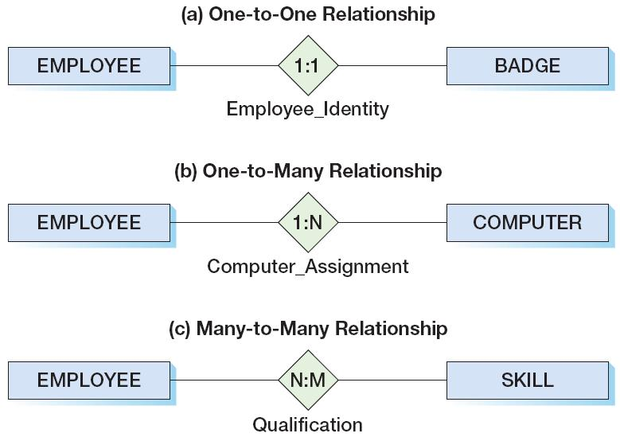
The Three Types of Maximum Cardinality

Slide 22
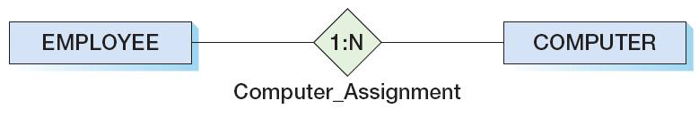
Parent and Child Entities
In a one-to-many relationship:
The entity on the one side of the relationship is called the parent entity or just the parent.
The entity on the many side of the relationship is called the child entity or just the child.
In the figure below, EMPLOYEE is the parent and COMPUTER is the child:

Slide 23
HAS-A Relationships
The relationships we have been discussing are known as HAS-A relationships:
Each entity instance has a relationship with another entity instance.
An EMPLOYEE has one or more COMPUTERs.
A COMPUTER has one assigned EMPLOYEE.

Slide 24
Minimum Cardinality
Minimum cardinality is the minimum number of entity instances that must participate in a relationship.
Minimums are generally stated as either zero or one:
IF zero [0] THEN participation in the relationship by the entity is optional, and no entity instance must participate in the relationship.
IF one [1] THEN participation in the relationship by the entity is mandatory, and at least one entity instance must participate in the relationship.

Slide 25
Indicating Minimum Cardinality
As shown in the examples in a following slide:
Minimum cardinality of zero [0] indicating optional participation is indicated by placing an oval next to the optional entity.
Minimum cardinality of one [1] indicating mandatory (required) participation is indicated by placing a vertical hash mark next to the required entity.

Slide 26
Reading Minimum Cardinality
Look toward the entity in question:
IF you see an oval THEN that entity is optional (minimum cardinality of zero [0]).
IF you see a vertical hash mark THEN that entity is mandatory (required) (minimum cardinality of one [ 1]).

Slide 27
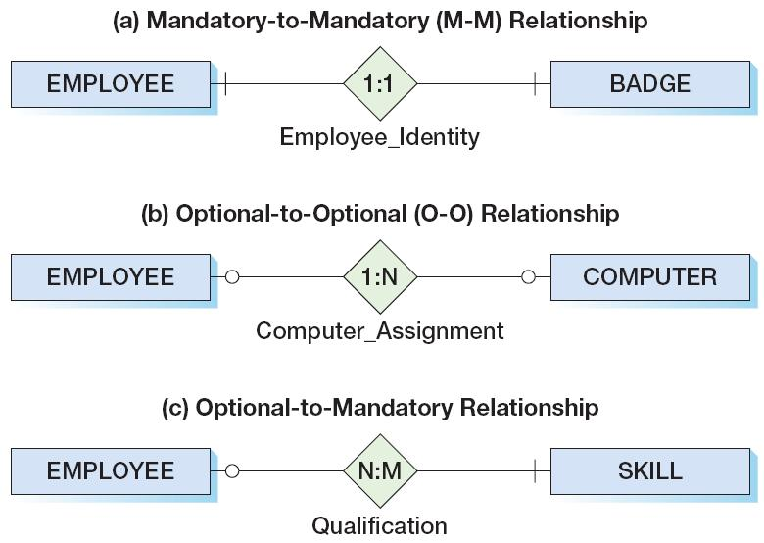
The Three Types of Minimum Cardinality
Notes:
(b) Employee는 다수의 Computer를 할당받을 수 있으나 반드시 Computer가 할당되어야 하는 것은 아니다. Computer도 한 명의 Employee가 정해질 수 있으나 없을 수도 있다.
(c) Employee는 반드시 하나 이상의 Skill을 가져야 하고, Skill은 여러 Employee에 의해 소유될 수 있으나 반드시 소유되어야 하는 것은 아님. 반대편 쪽에 대한 요구 사항임.

Slide 28
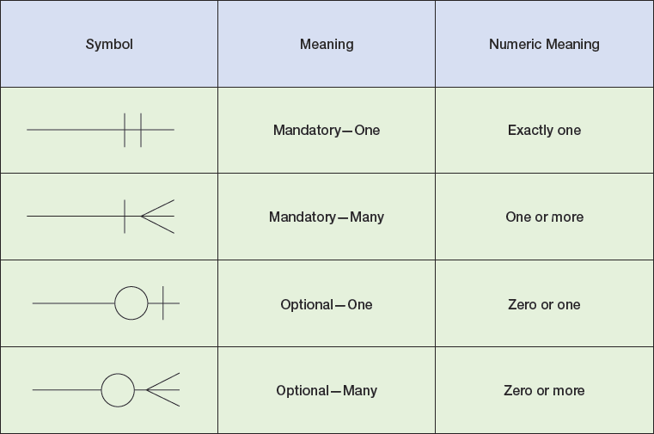
Data Modeling Notation: IE Crow’s Foot

Slide 29
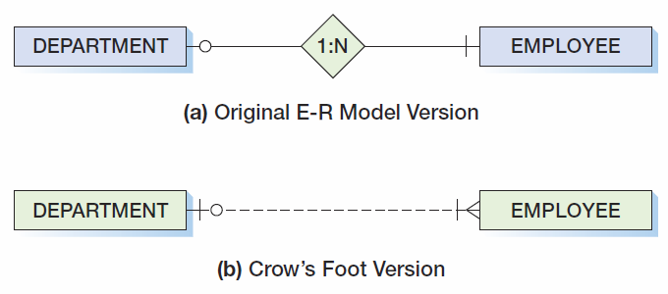
Data Modeling Notation: IE Crow’s Foot 1:N
Notes:
IE Crow 표기에서 실선은 ID-Dependent, 점선은 Weak-Entity와의 관계를 표시. ID-Dependent는 Child쪽에 Parent의 식별자를 키로 포함. 점선은 그렇지 않음.
점선은 Non ID-Dependent인 Weak Entity와의 관계를 표시..
뒤의 내용을 살펴보면 점선은 Non-identifying relationship에 사용하는듯.
의미: Department는 하나 이상의 Employee를 가질 수 있으나, Employee는 하나 또는 부서가 없을 수 있다.

Slide 30
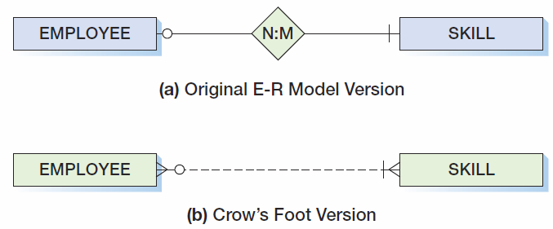
Data Modeling Notation: IE Crow’s Foot N:M
Notes:
HAS-A 관계로 설명.
Employee는 Skill에 대해 mandatory와 다수의 관계를 보유. 즉 반드시 Skill을 가지며 다수의 Skill이 보유 가능.
Skill은 Employee에 대해 Optional과 다수의 관계를 보유. 즉 보유한 Employee는 Optional이나 다수의 Employee에 의해 소유될 수 있음.

Slide 31
ID-Dependent Entities
An ID-dependent entity is an entity (child) whose identifier includes the identifier of another entity (parent).
The ID-dependent entity is a logical extension or subunit of the parent:
BUILDING : APARTMENT
PAINTING : PRINT
The minimum cardinality from the ID-dependent entity to the parent is always one.

Slide 32
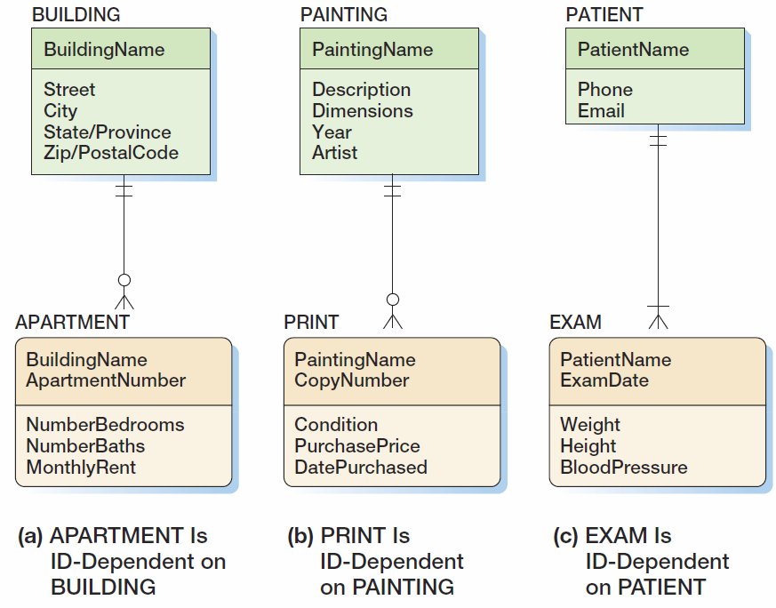
ID-Dependent Entities
Notes:
ID-Dependent Entity는 둥근 모서리의 사각형으로 표시 + Parent와의 관계는 실선으로 표시 : 전체적으로 식별관계를 의미

Slide 33
Weak Entities
A weak entity is an entity whose existence depends upon another entity.
All ID-Dependent entities are considered weak.
There are also non-ID-dependent weak entities.
The identifier of the parent does not appear in the identifier of the weak child entity.
Notes:
Weak Entity의 반대: Strong Entity.

Slide 34
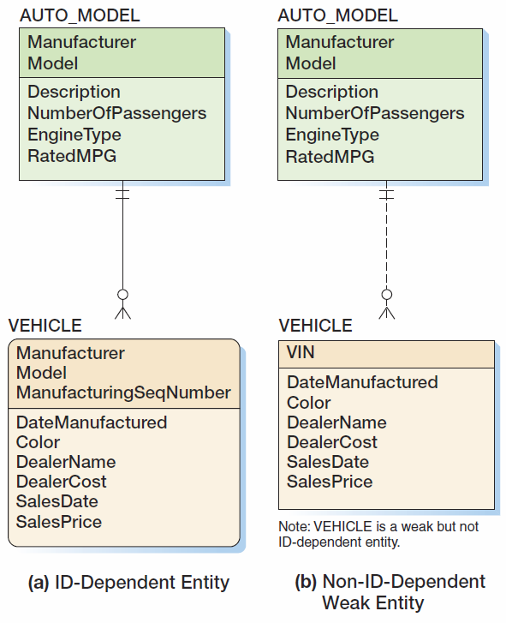
Weak Entities
Notes:
(b)는 모서리가 둥글지 않은 사각형. 점선으로 연결됨.

Slide 35
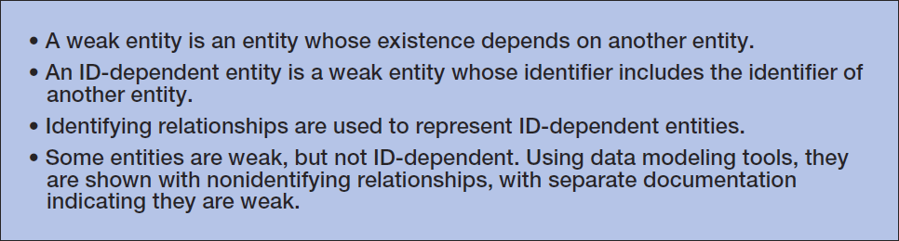
ID-Dependent and Weak Entities

Slide 36
Subtype Entities
A subtype entity is a special case of a supertype entity:
STUDENT : UNDERGRADATE or GRADUATE
The supertype contains all common attributes, while the subtypes contain specific attributes.
The supertype may have a discriminator attribute which indicates the subtype.

Slide 37
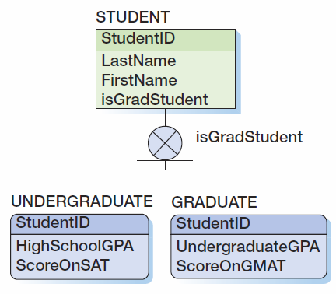
Subtypes with a Discriminator

Slide 38
Subtypes: Exclusive or Inclusive
If subtypes are exclusive, one supertype relates to at most one subtype.
If subtypes are inclusive, one supertype can relate to one or more subtypes.

Slide 39
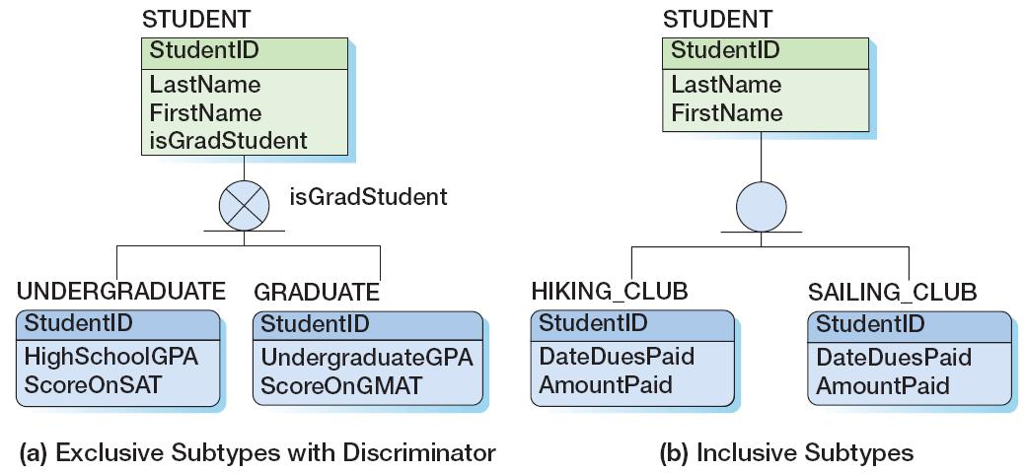
Subtypes: Exclusive or Inclusive

Slide 40
Subtypes: IS-A Relationships
Relationships connecting supertypes and subtypes are called IS-A relationships, because a subtype is a supertype.
The identifier of the supertype and all of its subtypes must be identical; i.e., the identifier of the supertype becomes the identifier of the related subtype(s).
Subtypes are used to avoid value-inappropriate nulls.

Slide 41
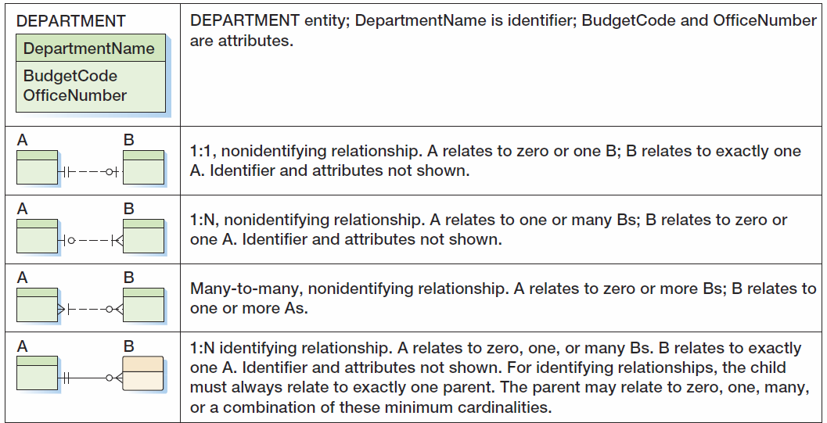
IE Crow’s Foot Symbol Summary I

Slide 42
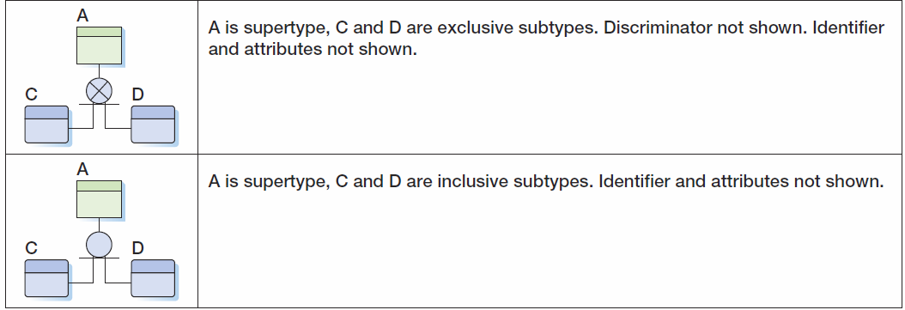
IE Crow’s Foot Symbol Summary II

Slide 43
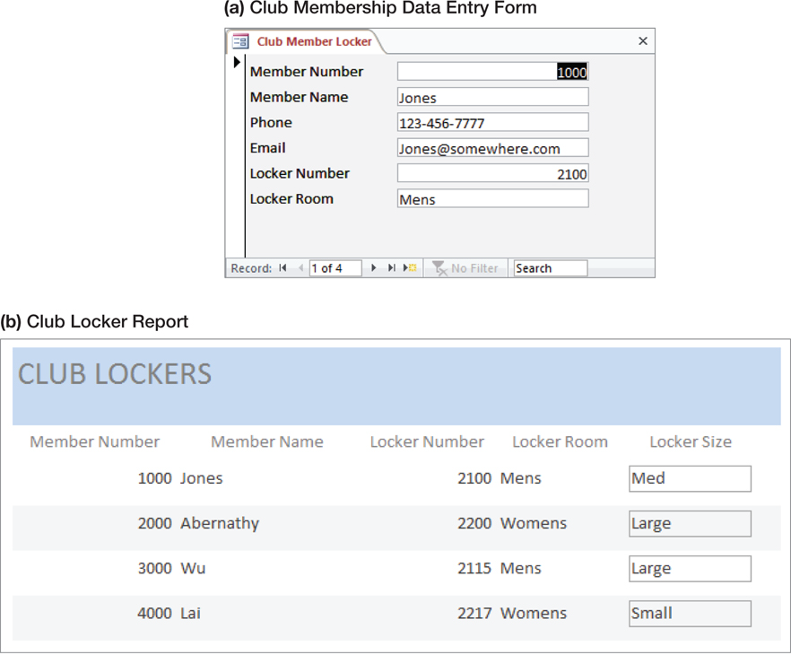
Strong Entity Patterns: 1:1 Strong Entity Relationships
Notes:
기존의 보고서나 어플리케이션을 통해 E-R 스키마를 도출 가능
Data Entry Form : 많아야 하나의 Locker 소유의 의미
Club Locker Report : Locker는 하나의 회원이 소유.

Slide 44
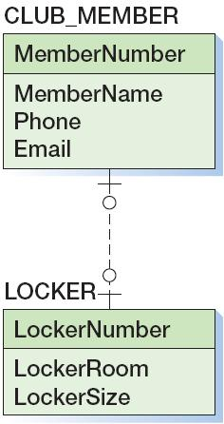
Strong Entity Patterns: 1:1 Strong Entity Relationships

Slide 45
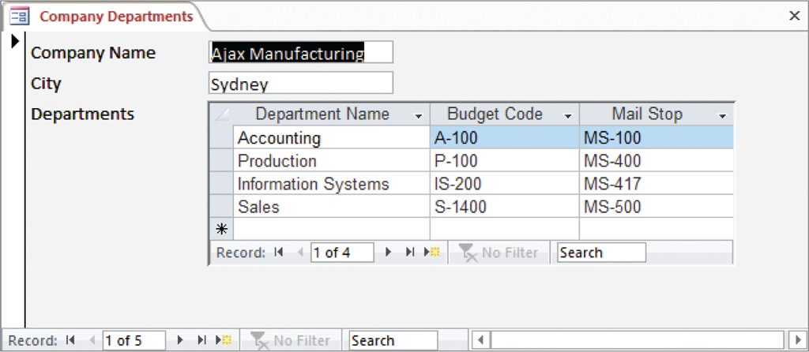
Strong Entity Patterns: 1:N Strong Entity Relationships
Notes:
Company vs. Departments
하나의 부서가 여러 회사에 속하는 양식/문서는 존재하지 않음. 따라서 1:N

Slide 46
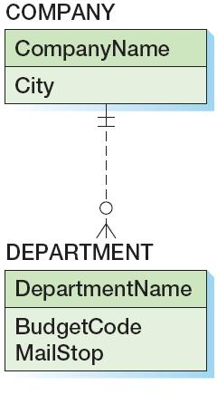
Strong Entity Patterns: 1:N Strong Entity Relationships

Slide 47
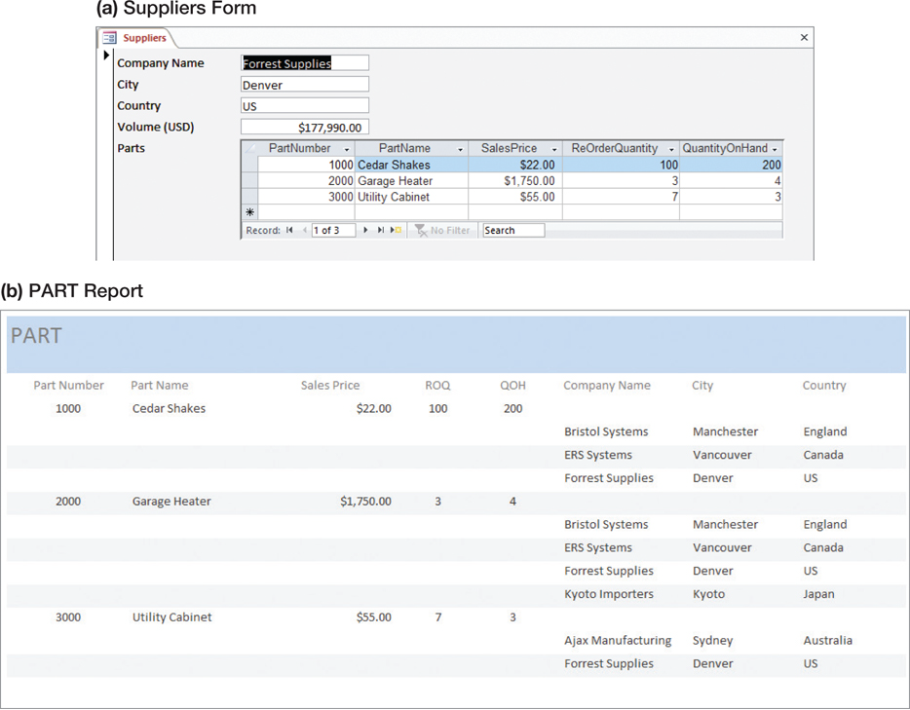
Strong Entity Patterns: N:M Strong Entity Relationships
Notes:
Supplier 양식: 다수의 Part를 Supply
Part 보고서 : 다수의 회사가 Supply함.

Slide 48
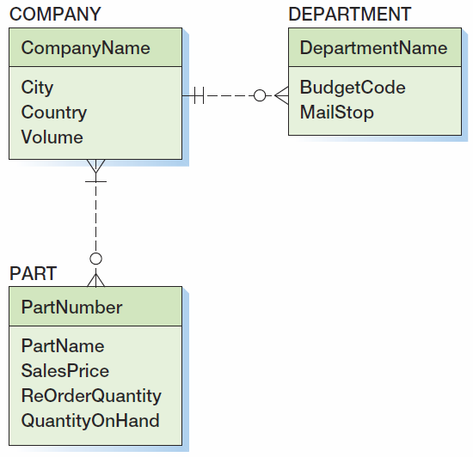
Strong Entity Patterns: N:M Strong Entity Relationships
Notes:
주의: 회사가 항상 부품을 납품해야 하는 것은 아님. 그러나 부품은 납품회사가 존재해야.

Slide 49
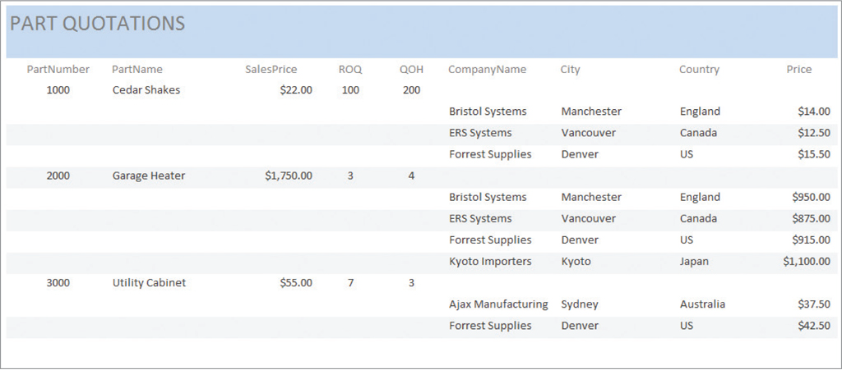
ID-Dependent Relationships: The Association Pattern
Notes:
회사, 부품간의 association(연관) 관계 → 부품 견적

Slide 50
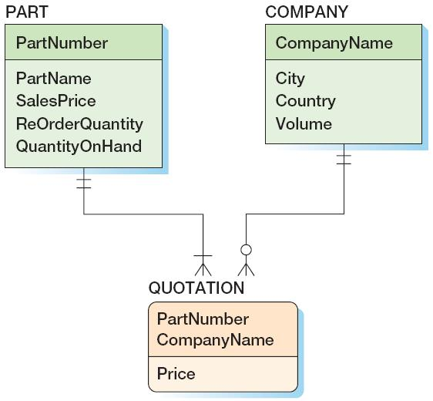
ID-Dependent Relationships: The Association Pattern
Notes:
Association은 속성이 있는 Relationship으로 이해할 수…. 이 경우 양쪽으로부터 ID-dependent.

Slide 51
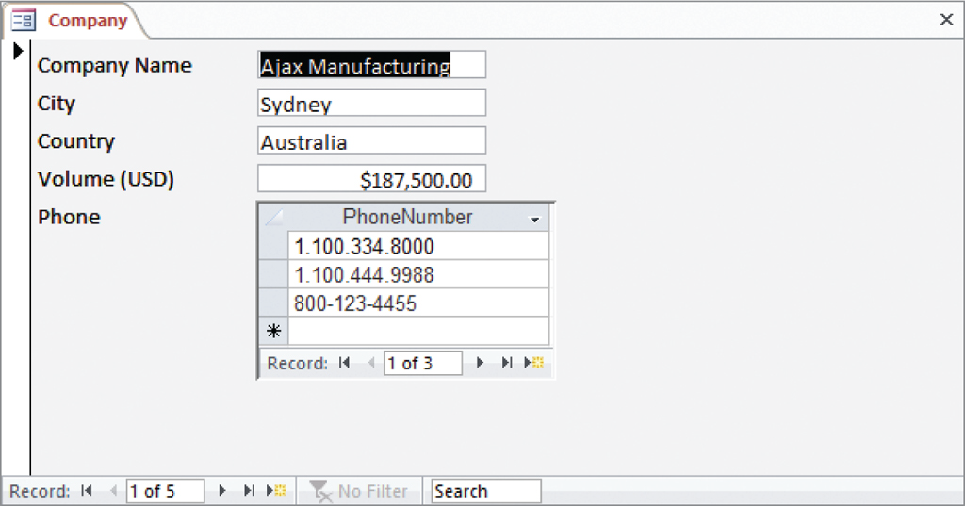
ID-Dependent Relationships: The Multivalued Attribute Pattern

Slide 52
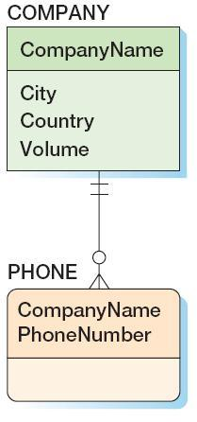
ID-Dependent Relationships: The Multivalued Attribute Pattern

Slide 53
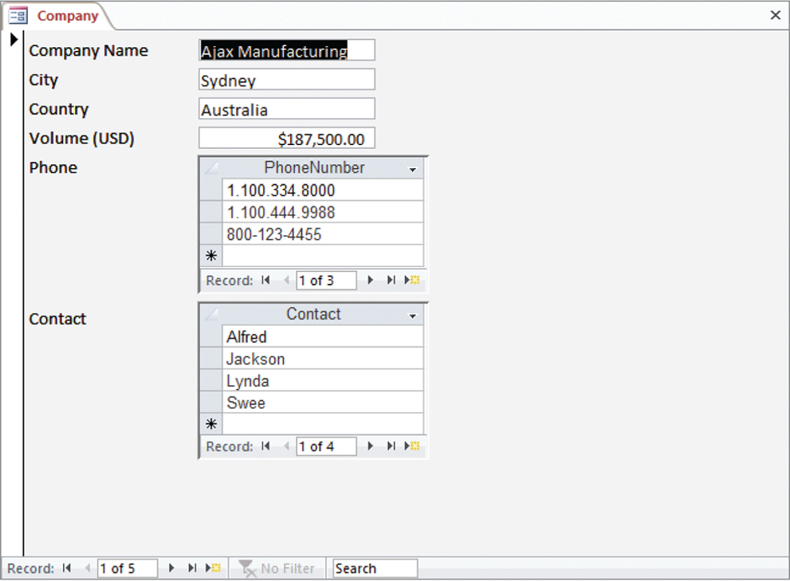
ID-Dependent Relationships: The Multivalued Attribute Pattern

Slide 54
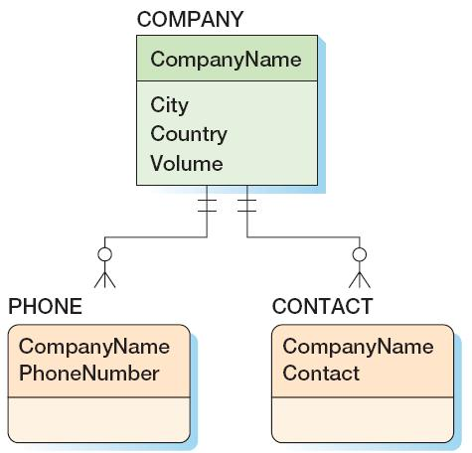
ID-Dependent Relationships: The Multivalued Attribute Pattern

Slide 55
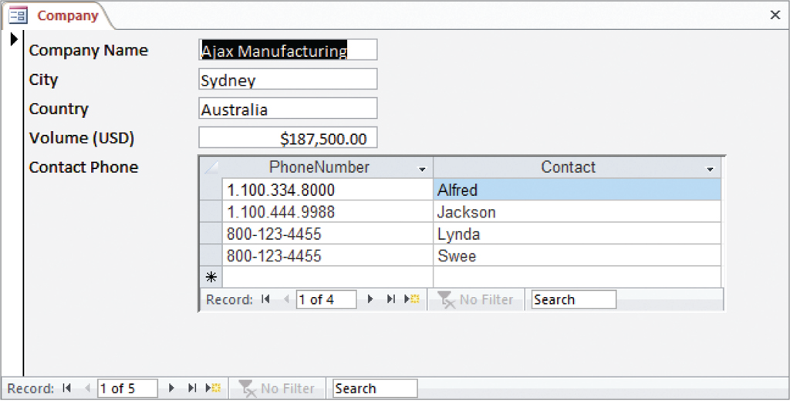
ID-Dependent Relationships: Composite Multivalued Attributes

Slide 56
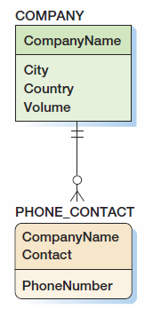
ID-Dependent Relationships: Composite Multivalued Attributes

Slide 57
ID-Dependent Relationships: The Archetype/Instance Pattern
The archetype/instance pattern occurs when the ID-dependent child entity is the physical manifestation (instance) of an abstract or logical parent.
PAINTING : PRINT
CLASS : SECTION
YACHT_DESIGN : YACHT
HOUSE_MODEL: HOUSE
Notes:
Archetype: 원형, 전형
An archetype is something that is considered to be a perfect or typical example of a particular kind of person or thing, because it has all their most important characteristics.

Slide 58
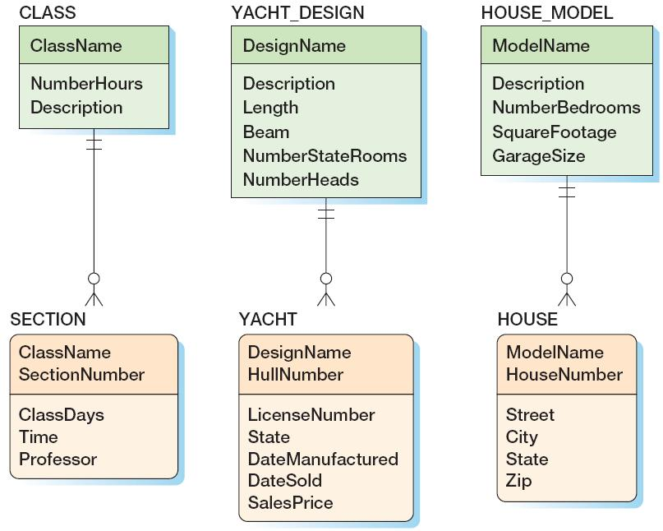
ID-Dependent Relationships: The Archetype/Instance Pattern
Notes:
Hull: (배의) 선체(네이버 사전)

Slide 59
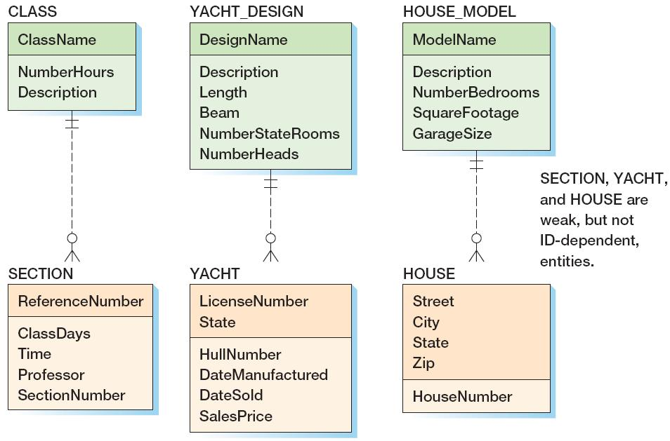
ID-Dependent Relationships: The Archetype/Instance Pattern
Notes:
ID-dependent와의 차이점: 테이블 설계 시 ID-dependent의 경우는 부모의 ID를 기본 키에 포함. 그러나 Weak, but Non-ID dependent entity의 경우는
외래키로 부모의 ID를 참조하면 될 듯. 사용 환경의 변화에 따라 존재 종속의 의미가 변할 수 있음. 또한 Application에서의 사용 형태에 따라 부모 객체의 존재가
의미 없는 경우도 있을 수 있음.
원래 출발은 Weak entity 개념으로 시작. ID-dependent 개념은 나중에 도입됨.

Slide 60
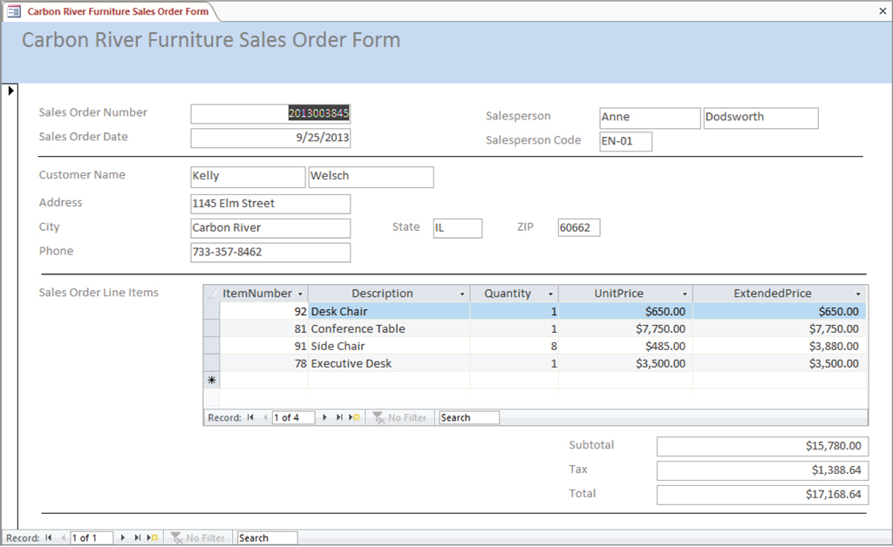
Mixed Patterns: The Line-Item Pattern
Notes:
Sale Order의 Line Item에 주의

Slide 61
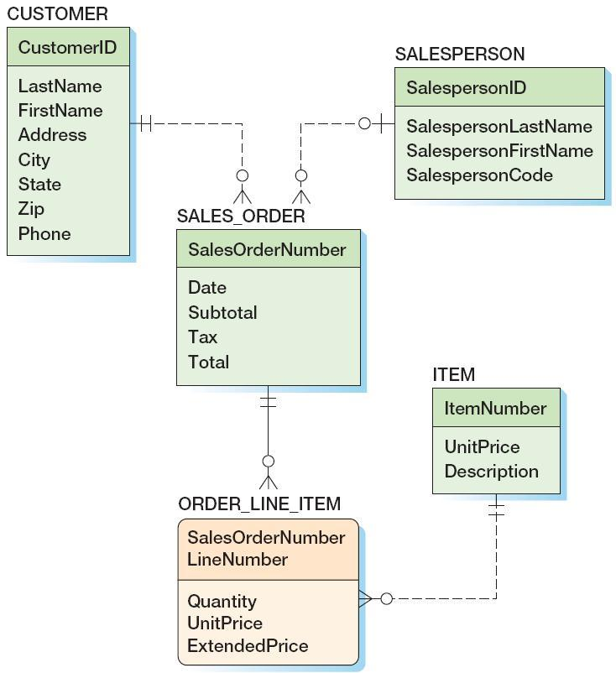
Mixed Patterns: The Line-Item Pattern
Notes:
ITEM의 unitprice는 현 시점의 가격. ORDER_LINE_ITEM의 unitprice는 주문 시점의 가격

Slide 62
Mixed Patterns: Other Mixed Patterns
Look for a mixed pattern where:
A strong entity has a multivalued composite group
One of the elements of the composite group is an identifier of another strong entity.

Slide 63
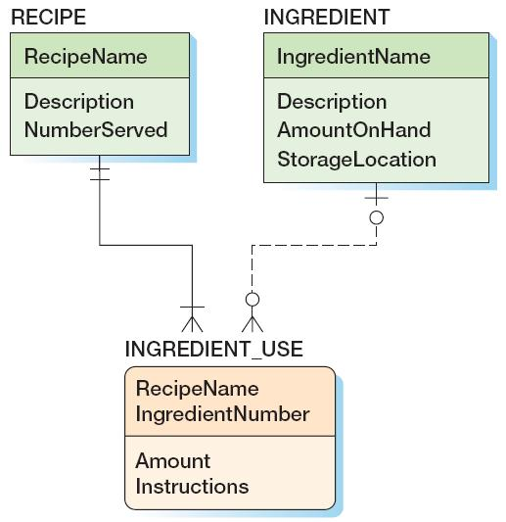
Mixed Patterns: Other Mixed Patterns

Slide 64
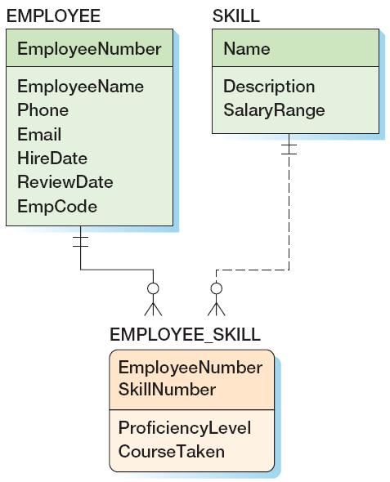
Mixed Patterns: Other Mixed Patterns

Slide 65
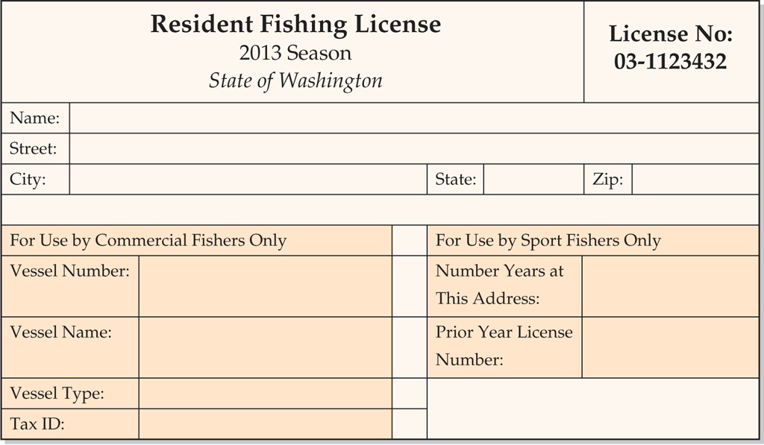
Mixed Patterns: The For-Use-By Pattern
Notes:
Vessel: 선박

Slide 66
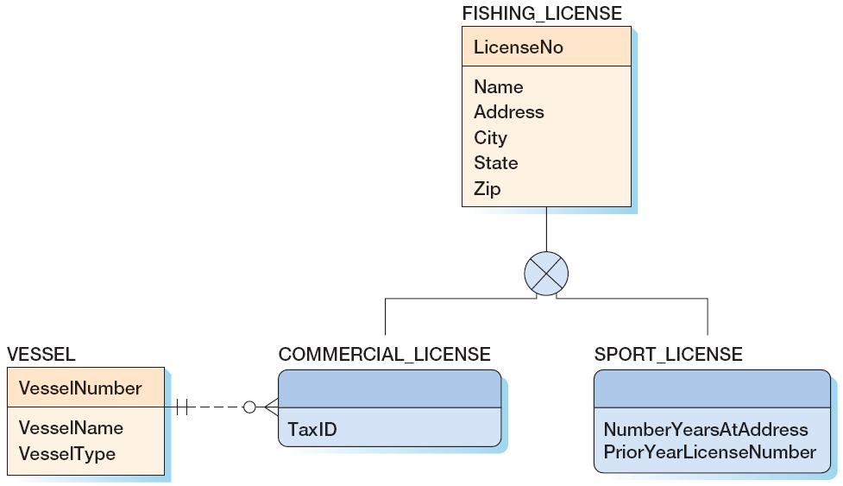
Mixed Patterns: The For-Use-By Pattern

Slide 67
Recursive Relationships
A recursive relationship occurs when an entity has a relationship to itself.

Slide 68
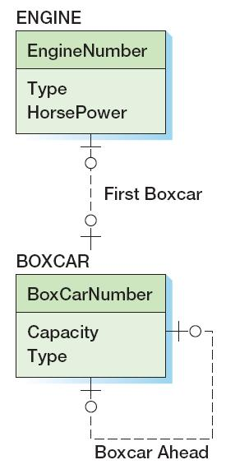
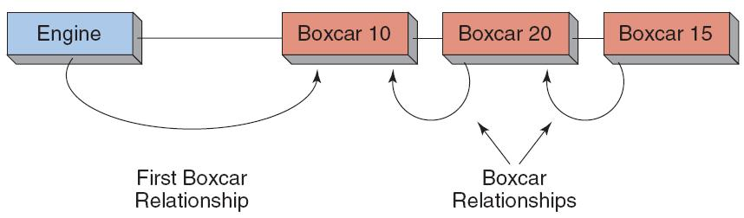
Recursive Patterns: 1:1 Recursive Relationship
Notes:
Boxcar :화차

Slide 69
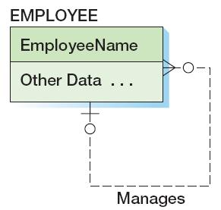
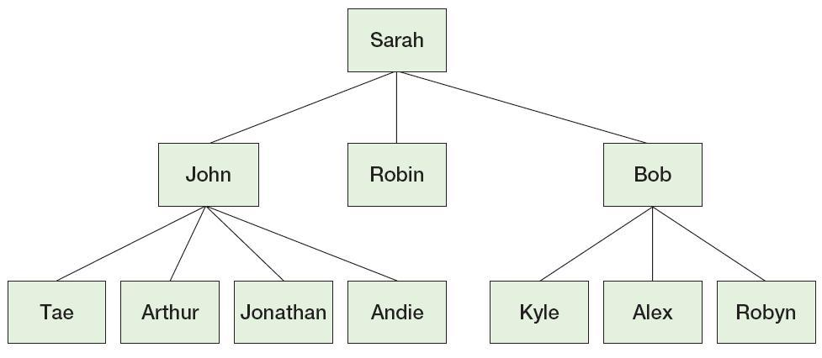
Recursive Patterns: 1:N Recursive Relationship

Slide 70
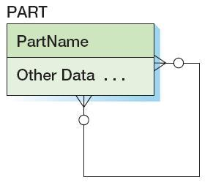
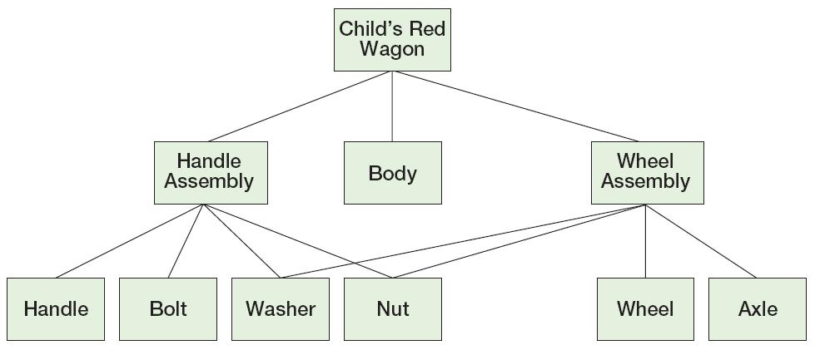
Recursive Patterns: N:M Recursive Relationship
Notes:
Part entity의 relationship 연결선이 점선이어야????

Slide 71
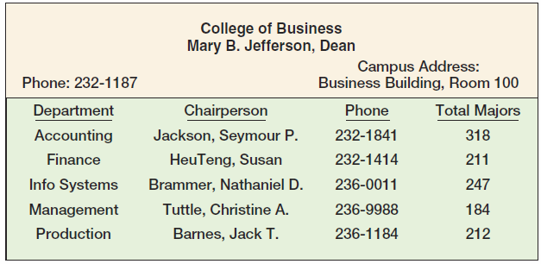
Highline University The College Report

Slide 72
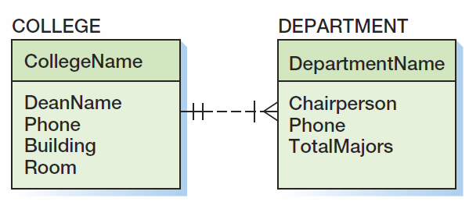
Highline University First Data Model

Slide 73
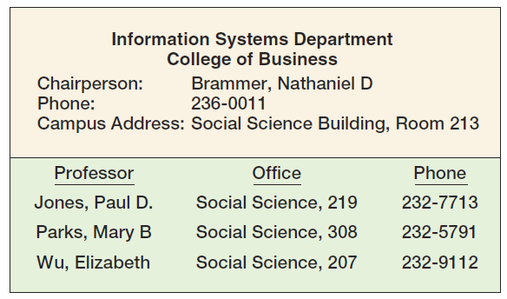
Highline University The Department Report

Slide 74

Highline University Second Data Model
Notes:
Department에 Building, Room(즉 주소) 추가.
교수가 여러 학과에 소속되어있을 수 있다는 가정하에 N:M으로 관계 구성. 이 부분은 추가 조사 필요. 만일 N:M관계에 속성이 필요하면 Association으로 표현해야.

Slide 75

Highline University Second Data Model

Slide 76

Highline University Second Data Model

Slide 77

Highline University Second Data Model
Notes:
Department의 Chairperson 대신 Professor에 대한 관계로 표현.

Slide 78

Highline University The Department Student Report
Notes:
Major’s Name은 학생 이름을 의미.

Slide 79

Highline University Third Data Model

Slide 80

Highline University Sample Student Acceptance Letter
Notes:
Acceptance letter 내에 Advisor가 표시됨. 교수는 여러 학과에 소속될 수 있으며 학과와의 소속 관계에서 학생을 지도한다고 가정.

Slide 81

Highline University Fourth Data Model

Slide 82

Highline University Final Data Model
Notes:
FirstName, LastName으로 구분.

Slide 83
David Kroenke and David Auer Database Processing Fundamentals, Design, and Implementation (13th Edition)
End of Presentation:
Chapter Five

Slide 84

All rights reserved. No part of this publication may be reproduced, stored in a retrieval system, or transmitted, in any form or by any means, electronic, mechanical, photocopying, recording, or otherwise, without the prior written permission of the publisher. Printed in the United States of America.

